Slide 1
Introduction to Early Help in Doncaster

Slide 2

Notes:
Introduction of trainers
House keeping – fire, toilets, breaks, mobile phones
Confidentiality and safe learning environment

Slide 3
Course Outcomes
To have of understanding of what Early Help is and when it is required, including the application of threshold guidance.
To have an understanding of the Early Help Pathway.
To develop knowledge and understanding of signs of safety.
To understand that CAF is now replaced with EHA.

Slide 4

What is Early Help?
Notes:
Ice breaker
Each group have 1 minute to write down as many words they think are associated with EH as possible
Each group to shout out 3

Slide 5
Background – Doncaster Serious Case Reviews
Children J
Child K
Child A
Child B and Child C
Notes:
How we have got to today
Do people know who these children are?
How has this led to Early Help as we know it today?
Be sure that everyone has heard of Child A and have read it and know it.
Pull out similarities to child K and child B & C as with child K child A died just a few days short of 11 weeks old.
Pull out key point that the mid wife had though she had made a referral to R&R by telephoning them when in fact this was only a contact not a referral
Child K – Died May 2008 aged 11 weeks – father pleaded guilty to murder.
At no stage during the 21⁄2 year period covered by this review did anyone complete a Common Assessment Framework in respect of either child despite several occasions when it would have been appropriate to have done so. This review has found that the Common Assessment Framework has not been embedded in practice in Doncaster and is still not being used on a regular basis as it should be. This has been recognised by Children’s Social Care and an independent specialist was appointed in September 2008 to review the application of the common assessment framework. The review demonstrated an inconsistent approach across the agencies to the identification and assessment of needs. An implementation plan has been drawn up to address this, with policies, procedures and a performance framework due to be in place by April 2009.
Child B and Child C – Child B died December 2007 at 16 months old having suffered repeated multiple non accidental injuries
The Chairs of Doncaster Safeguarding Children Board and the Doncaster Children’s Trust should within twelve months ensure that the Common Assessment Framework and the related agenda of ‘Common Thresholds of intervention’, ‘Lead professionals ‘and suitable training is fully embedded into local inter-agency policy and practice.
J children: January 2010 – violent attacks on 2 brothers
The Doncaster Safeguarding Children Board should agree and deliver a training and staff development strategy that describes clear objectives and outcomes for ensuring relevant professionals have access to and participate in training that promotes their effective working with other services and professionals. Priority should be given to ensuring a common understanding about referral pathways to services that includes the use of common assessments, how to assess risk and identify children in need and the frameworks within which judgements and decisions need to be made. The strategy should be agreed and be in place within three months.

Slide 6
So what is Early Help?
The Children and Families Strategic Board (CFB) has defined early help as:
‘The job of all public, private, voluntary and community services as well as citizens in Doncaster, is to prevent and intervene early with children, young people and families experiencing problems in order to prevent escalation of problems. This will deal with root causes, providing support at an early age and an early stage of problems emerging. We will do this by taking a whole family approach and intervening in a co-ordinated way.’

Slide 7

Yes….
But what does that actually mean?
Notes:
Firstly – CAF / Common Assessment Framework is Now called Early Help / Early Help Assessment
The principles are the same and much of the process with a few changes, a re-invigoration
Simply explain what it is:
Consent based process
Holistic
Team around the child
Use an example of a family you know – for example:
Joe is a 9 year old boy in primary school, he has presented no real concerns during his time at the school and is progressing well. Quite suddenly his behaviour changes, he is not settled in class and causing constant low level disruption. His parents are called in to discuss his behaviour and some mentoring put in place in school. Joe’s behaviour continues to escalated and neither his parents or school can understand why, however it is getting to the point where he might be excluded.
The school with the parents consent begin the early help process with screening recommendation being progress to EHA.
During the assessment phase Joe’s mum informs the school her mother died 4 months ago, but Joe had only met her 4 times because she lived in Spain. So mum did not think it had an effect on him. After further exploration with Joe, it transpired this was the root cause of his behaviour change. Now that everyone was aware of the cause he could be support more effectively. Include 6 weeks of bereavement counseling. Joe’s EHA episode was closed 3 months after it was opened.

Slide 8
Key Documents
Multi Agency Early Help Strategy
Early Help Practice Handbook
Threshold Guidance
www.doncastersafeguardingchildren.co.uk

Slide 9
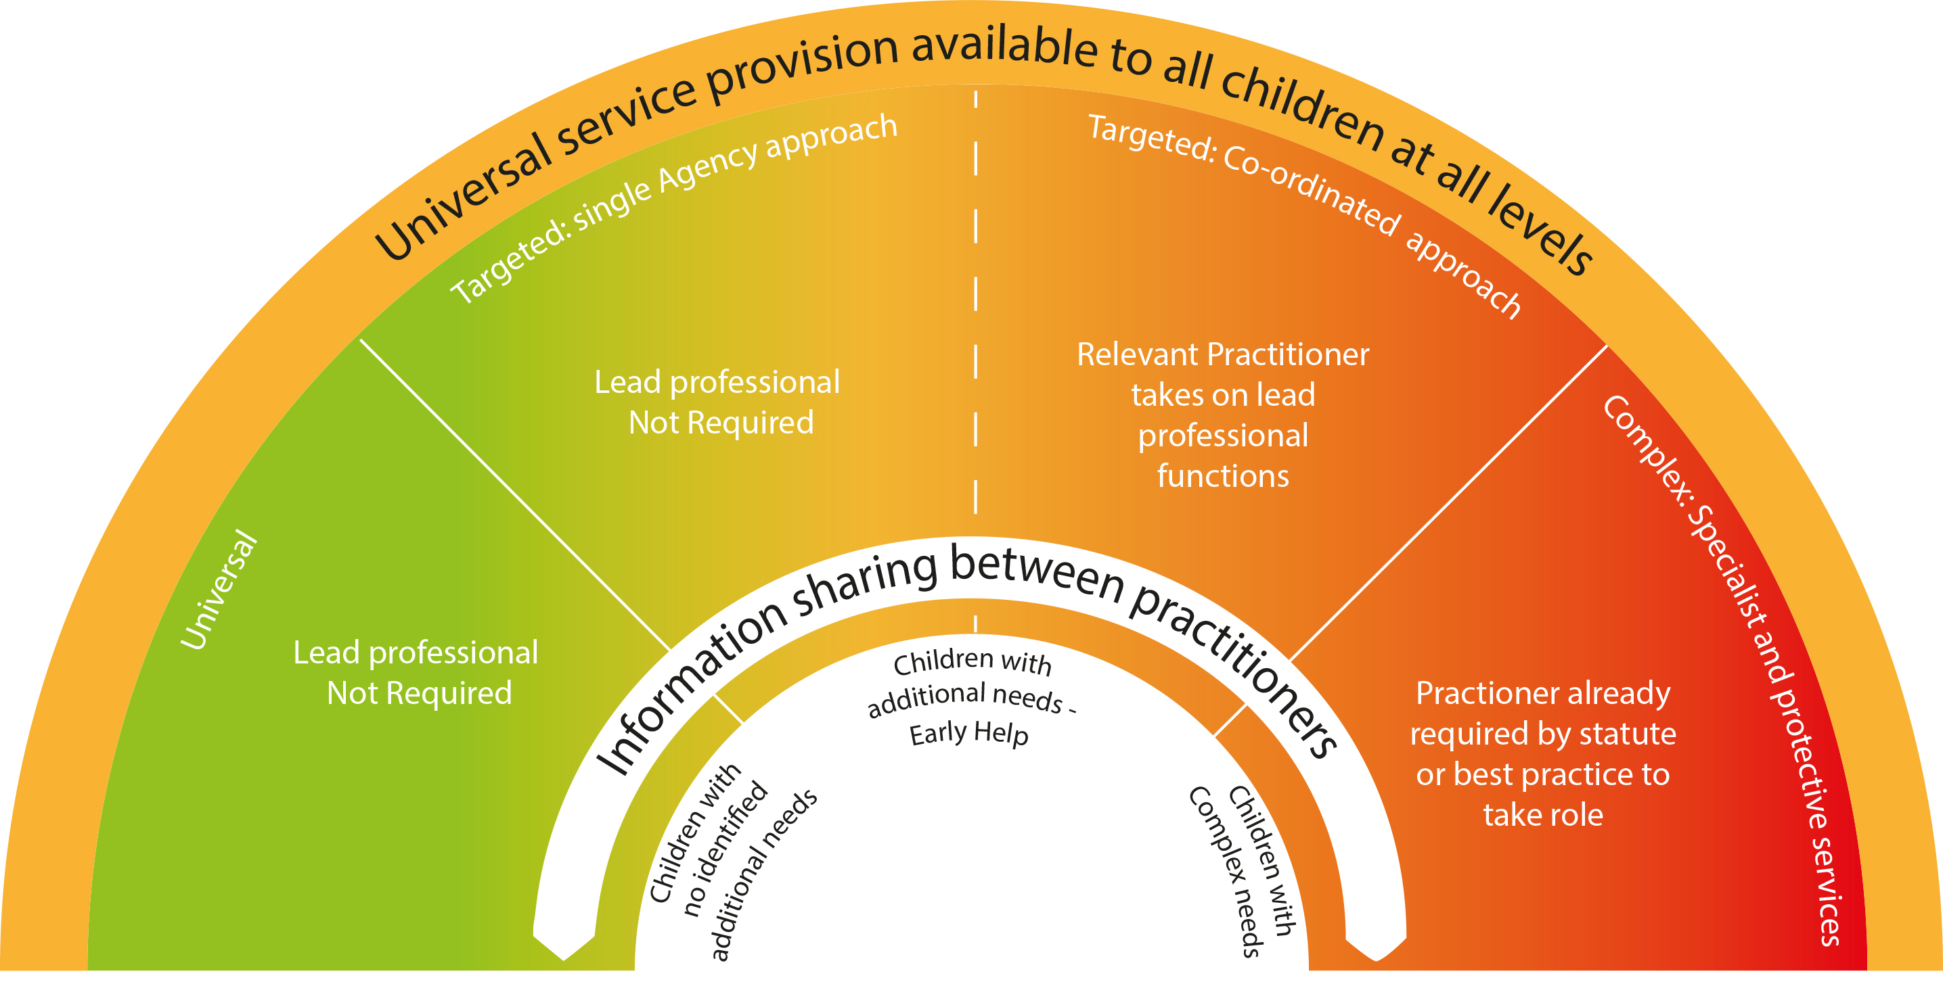
Thresholds
Notes:
Ensure delegates are clear at what point Early Help begins – top end level 2 and level 3

Slide 10
Notes:
Delegates directed to P8 of practitioners handbook to follow through the process.
Ensure all participants are aware that the rest of the training will look at each stage in detail and what they need to do when
Note:
EHM is only referred to throughout the training and what needs to be done when. There is not enough time in this course to go into EHM in detail – please direct participants to the training, workshops and support on offer
Make sure people know that at any point in the process it can be referred back to Hub or R&R (direct to the ‘wider’ additional needs pathway in handbook.
STATS: As of 18/04/16 (From 1st November 2015)
1051 EHA allocated by hub
915 still open
Only 59% of assessments have been started and 25% complete
Allocations:
50% to IFST and FS
40% to schools
2.5% (23) to HV

Slide 11

Thresholds
Notes:
Reiterate to practioners the importnace of using and understanding Thresholds.

Slide 12
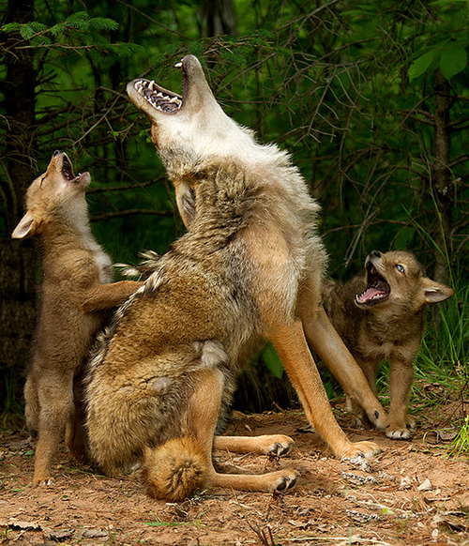
Early Help Assessment - EHA
Information gathering
Analysing the information to identify what needs to change and how
Notes:
This section is going to focus on part 1:
Weighing things up.
Exploring the situation fully
Assessing
What needs to change
Identifying what you can do
Identifying what others can do
Communication with family and other professionals.
Review situation.
Tips for a good assessment
Give a clear reason (rationale) for beginning an Early Help Assessment.
Evidencing findings with examples.
The Voice of the Child must be clear – includes observations and evidence from direct work.
Holistic approach –involve other family members and professionals. No one person has ‘the full picture’.
Triangulation – don’t take things at face value, confirm findings with others.
Explore family history, functioning and support.
Be brave, ask questions.
Be aware of the possibility of minimisation and avoidance.
Analysis – What does all this mean? What is the impact on the Child? What needs to change?

Slide 13
Signs of safety
What are you worried about? | What is working well? | What needs to happen?
Notes:
This is only a brief introduction – if this interest you / or a weakness in your knowledge then need to attend further training
Core principles:
Recognising that all families have signs of safety
Establishing constructive working relationships and partnerships between professionals and family members, and between professionals themselves
Engaging in critical thinking and maintaining a position of inquiry
Staying grounded in the everyday work of child protection practitioners
Not used in this detail at EHM but over riding principles are and can also help with analysis
Paired activity – in pairs use case study to consider: Using Sophie and Rebecca case study
What are you worried about?
What is working?
What needs to happen?
Bring whole group back together and review

Slide 14

Stronger Families
How is a family a Stronger Family?
The criteria for families to be eligible for the programme has been widened by the Government to:
Parents and children involved in crime or anti-social behaviour.
Children who have not been attending school regularly.
Children who need help.
Adults out of work or at risk of financial exclusion and young people at risk of worklessness. (NEET)
Families affected by domestic violence and abuse.
Parents and children with a range of health problems.
Notes:
Must complete the criteria on EHM
Helps to see what are the needs of families in Doncaster
Support to access additional funding / resources for these families

Slide 15
Help on hand
Early Help Coordinators
Telephone: 01302 736250
Email: earlyhelpcoordinator@doncaster.gov.uk
Esystems
Email: esystems.cyps@dcstrust.co.uk

Slide 16

Evaluation
Link to online evaluation will be sent out, please reflect on today and be honest, so we can improve.

Slide 17
What next?
Enrol for the Delivering Early Help – the Role of the Lead Practitioner
Feedback your learning here to your colleagues
Enrol your colleagues in a future Introduction course
Or all three or something else!

Slide 18


