Slide 1
Delivering Early Help:
The role of the Lead Practitioner

Slide 2

Notes:
Introduction of trainers
House keeping – fire, toilets, breaks, mobile phones
Confidentiality and safe learning environment

Slide 3
Course Outcomes
To have of understanding of what Early Help is and when it is required.
To have an understanding of the Early Help Pathway.
To develop understanding about what constitutes a good quality assessment.
To develop knowledge and understanding of signs of safety.
To gain understanding of the plan, deliver and review cycle within Early Help.
To create understanding and confidence in undertaking the. Lead Practitioner role.
To provide information about the role of the Early Help Coordinator.

Slide 4

Ice Breaker
Notes:
Ice breaker: Parenting: Values and attitudes
Slide 4
In 4 groups:
Ask delegates to write a list of 30 parenting behaviours, for example listening to their children, providing boundaries etc
Then ask delegates individually to list the behaviours under the headings (worksheets)
Essential parenting
Good parenting
Ideal parenting
Groups then share their lists – consider are they the same, are they different and what led us to allocating them in the way they have
Draw attention to our own personal experience, values and attitudes and how these can effect our assessments – consider the notion of suspending judgement based on our own values and using guidance such as threshold guidance to make decisions
Flip chart
Essential / Good / Ideal worksheets

Slide 5
Early Help in Doncaster
The Children and Families Strategic Board (CFB) has defined early help as:
‘The job of all public, private, voluntary and community services as well as citizens in Doncaster, is to prevent and intervene early with children, young people and families experiencing problems in order to prevent escalation of problems. This will deal with root causes, providing support at an early age and an early stage of problems emerging. We will do this by taking a whole family approach and intervening in a co-ordinated way.’

Slide 6
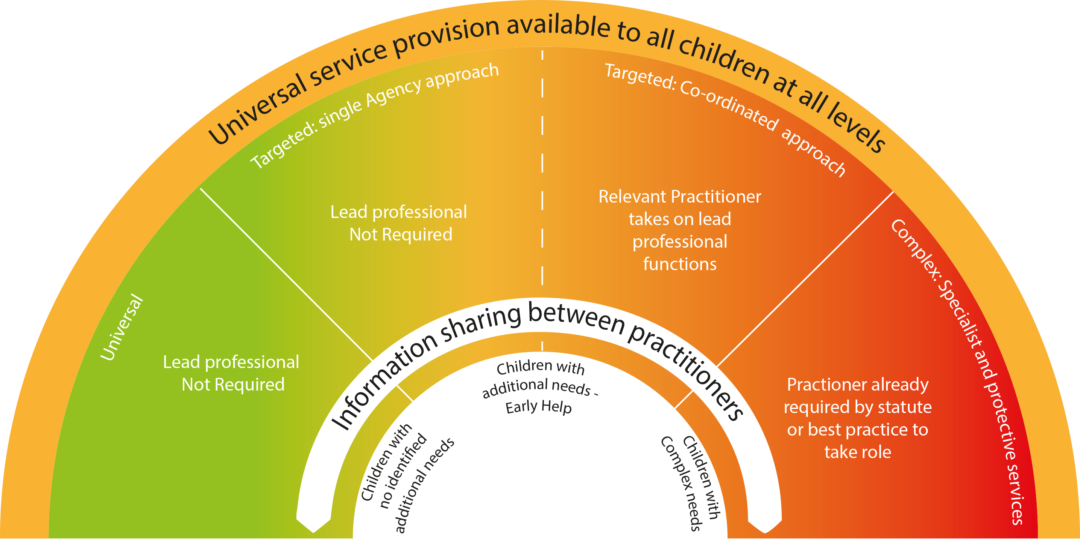
Thresholds
Notes:
Ensure delegates are clear at what point Early Help begins – top end level 2 and level 3

Slide 7
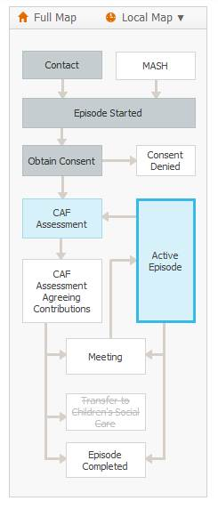
Notes:
Delegates directed to P8 of practitioners handbook to follow through the process.
Ensure all participants are aware that the rest of the training will look at each stage in detail and what they need to do when
Note:
EHM is only referred to throughout the training and what needs to be done when. There is not enough time in this course to go into EHM in detail – please direct participants to the training, workshops and support on offer
Make sure people know that at any point in the process it can be referred back to Hub or R&R (direct to the ‘wider’ additional needs pathway in handbook.
STATS: As of 18/04/16 (From 1st November 2015)
1051 EHA allocated by hub
915 still open
Only 59% of assessments have been started and 25% complete
Allocations:
50% to IFST and FS
40% to schools
2.5% (23) to HV

Slide 8
Understanding the importance of a coordinated response for families:
The Smith Family

Slide 9

Early Help Pathway in more detail
The Early Help Hub
and
Early Help Enquiry Form
Notes:
What is the hub – where based, who made up of, duty phone, links to R&R
What do I do?
Hub enquiry form, direct them to P23 of handbook – ask participants to think of a child who they know who might benefit from early help / who they are concerned about and what information do they already need and how will they go about getting the rest. Drawn attention to consent

Slide 10

Break time – 15 minutes

Slide 11

Role of the Lead Practitioner
Notes:
If you are identified as the lead practitioner it is your role to:
Act as a single point of contact for the child and parents so the family are kept well informed and can discuss their progress and any concerns with one person that they can trust
Undertake the Early Help Assessment and lead the subsequent process with the family
Act as a single point of contact for other professionals to report back to
Co-ordinate the delivery of actions agreed in the TAC/F and ensure that the package of support is regularly reviewed and monitored
Reduce any overlap and inconsistency in the services received
Support the child and family to ensure that a careful ‘handover’ takes place if it becomes more appropriate for someone else to be the lead practitioner.
Any questions or concerns?

Slide 12

Early Help Assessment - EHA
Information gathering
Analysing the information to identify what needs to change and how
Notes:
This section is going to focus on part 1:
Weighing things up.
Exploring the situation fully
Assessing
What needs to change
Identifying what you can do
Identifying what others can do
Communication with family and other professionals.
Review situation.
Tips for a good assessment
Give a clear reason (rationale) for beginning an Early Help Assessment.
Evidencing findings with examples.
The Voice of the Child must be clear – includes observations and evidence from direct work.
Holistic approach –involve other family members and professionals. No one person has ‘the full picture’.
Triangulation – don’t take things at face value, confirm findings with others.
Explore family history, functioning and support.
Be brave, ask questions.
Be aware of the possibility of minimisation and avoidance.
Analysis – What does all this mean? What is the impact on the Child? What needs to change?

Slide 13
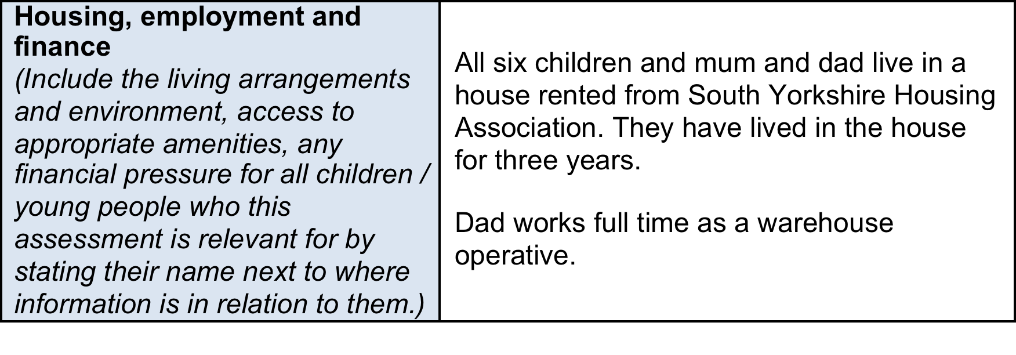

Slide 14
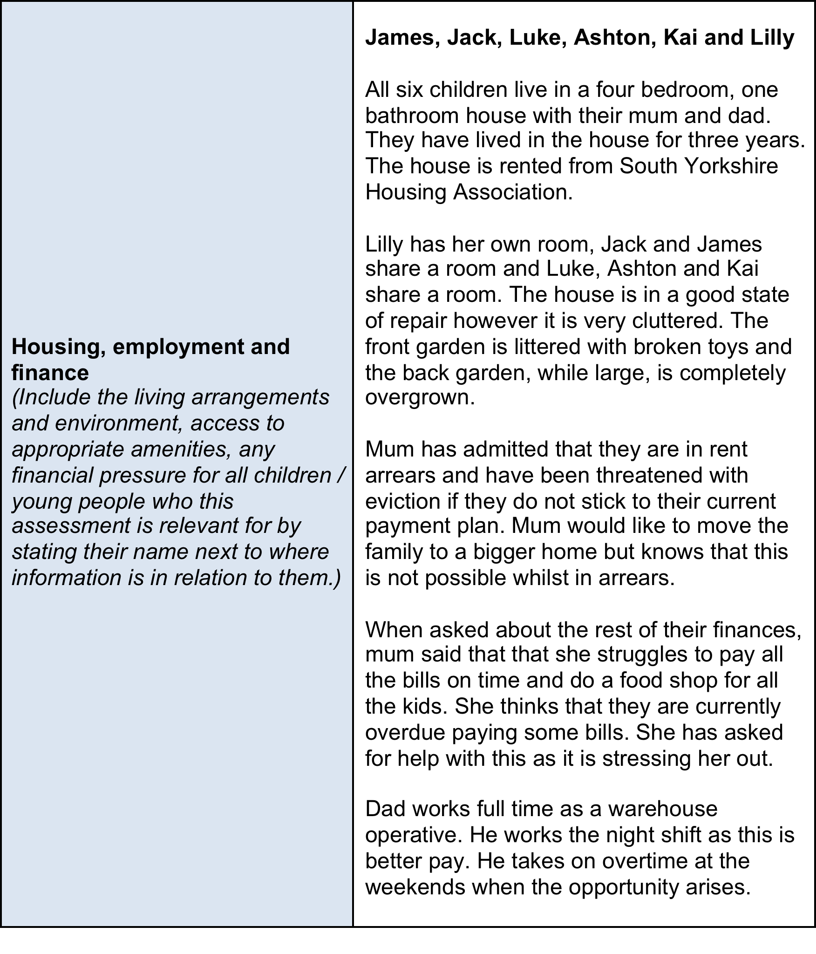

Slide 15
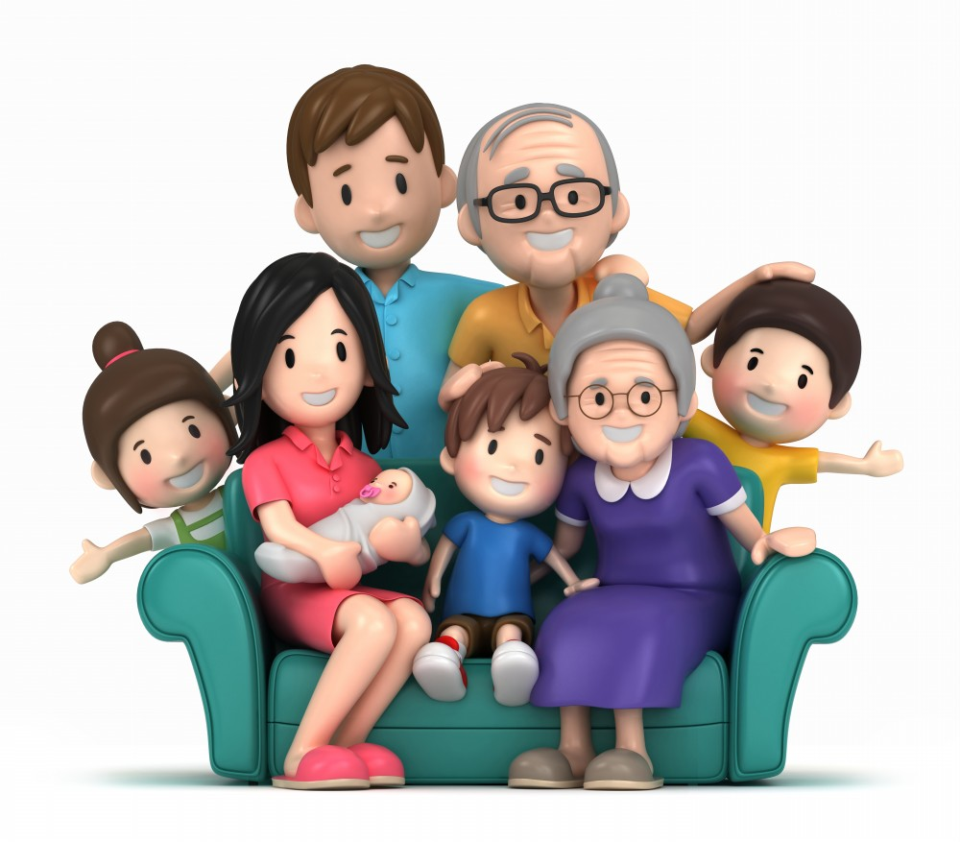
Ensuring children and families are involved in the whole early help process

Slide 16


Slide 17
Pause for thought
What makes the biggest difference?
A detailed analysis of all success for Early Help cases in Doncaster which were open and closed during the time frame 1st November 2015 and 31st October 2016 has shown that the biggest contributing factor to making cases successful is the speed at which assessments are complete after allocation from the Hub. The longer the assessment takes the less likely it is to be successful.

Slide 18
Signs of safety
What are you worried about? | What is working well? | What needs to happen?
Notes:
This is only a brief introduction – if this interest you / or a weakness in your knowledge then need to attend further training
Core principles:
Recognising that all families have signs of safety
Establishing constructive working relationships and partnerships between professionals and family members, and between professionals themselves
Engaging in critical thinking and maintaining a position of inquiry
Staying grounded in the everyday work of child protection practitioners
Not used in this detail at EHM but over riding principles are and can also help with analysis

Slide 19

What does the story mean – conclusions
Speed analysing:
In pairs, take one case study each. Read the case study to your partner who has three minutes to complete the what are you worried about and what is working well on the SoS. You have 3 minutes and then swap.
Notes:
Rotate: those who were not taking notes
Add / edit
Share with whole group
It is possible to do at speed!

Slide 20
Analysis and drawing conclusions from a complete Early Help Assessment
Now you can analysis quickly. Read through the example EHA to complete the conclusions section as an individual.

Slide 21
Need
Outcome
Plan
Outcomes must relate directly to need
An outcome is the benefit or difference as a result of an intervention
Notes:
Be very clear that in drawing conclusions not to jump straight to action.
All actions must relate clearly to an outcome and all outcomes must relate clearly to a need!

Slide 22

Team around the family and Plans

Slide 23

Plans

Slide 24

Stronger Families
How is a family a Stronger Family?
The criteria for families to be eligible for the programme has been widened by the Government to:
Parents and children involved in crime or anti-social behaviour.
Children who have not been attending school regularly.
Children who need help.
Adults out of work or at risk of financial exclusion and young people at risk of worklessness. (NEET)
Families affected by domestic violence and abuse.
Parents and children with a range of health problems.
Notes:
Must complete the criteria on EHM
Helps to see what are the needs of families in Doncaster
Support to access additional funding / resources for these families

Slide 25
Break time – 10 minutes

Slide 26

Undertaking direct work with children and families and recording on EHM
Notes:
Information giving:
As part of your plan you may or may not under take direct work, if you are you need to record on general notes in EHM and attach any documents
Less interested in this than the progress on plan and minutes
Vital in general notes is telephone calls, referrals etc, emails

Slide 27

Reviews

Slide 28

Closure

Slide 29
Supervision
“Effective professional supervision can play a critical role in ensuring a clear focus on a child’s welfare. Supervision should support professionals to reflect critically on the impact of their decisions on the child and their family…Any professional working with vulnerable children should always have access to a manager to talk through their concerns and judgements affecting the welfare of a child.”
Working Together to Safeguard Children, March 2015

Slide 30
Paired activity
Think of a time when you have personally received high quality supervision
Think of a time when you personally received poor quality supervision
Why were these two experiences so different?
How have you learnt from both experiences?
How can you ensure you receive high quality supervision?

Slide 31
Group activity:
The Early Help Process
Without referring to any other materials recreate the flow of EHA with the materials on your table.
Notes:
Reinforcement of process

Slide 32

Evaluation
Link to online evaluation will be sent out, please reflect on today and be honest, so we can improve.

Slide 33
Help on hand
Early Help Coordinators
Telephone: 01302 736250
Email: earlyhelpcoordinator@doncaster.gov.uk
Esystems
Email: esystems.cyps@dcstrust.co.uk

Slide 34


